Slide 1


CaChat
Is a Cross-Platform chatting Application targeting to allow users to use Real-Time chatting.

Slide 2

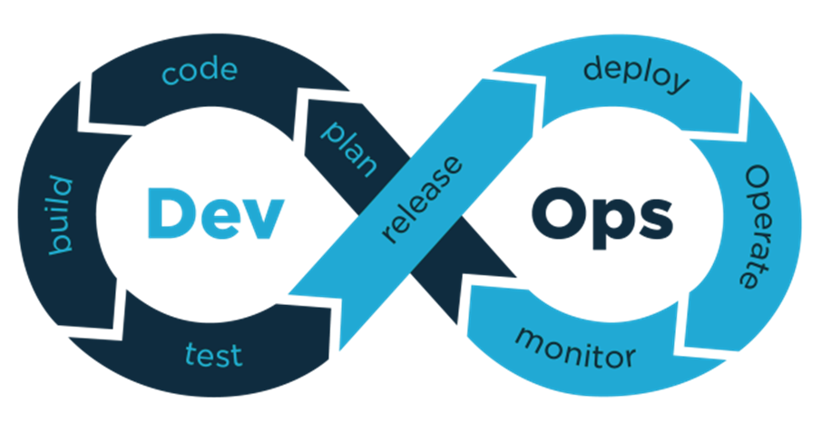
Dev-Ops
It aims to shorten the systems development life cycle and provide continuous delivery with high software quality. DevOps is complementary with Agile software development; several DevOps aspects came from the Agile methodology.

Slide 3
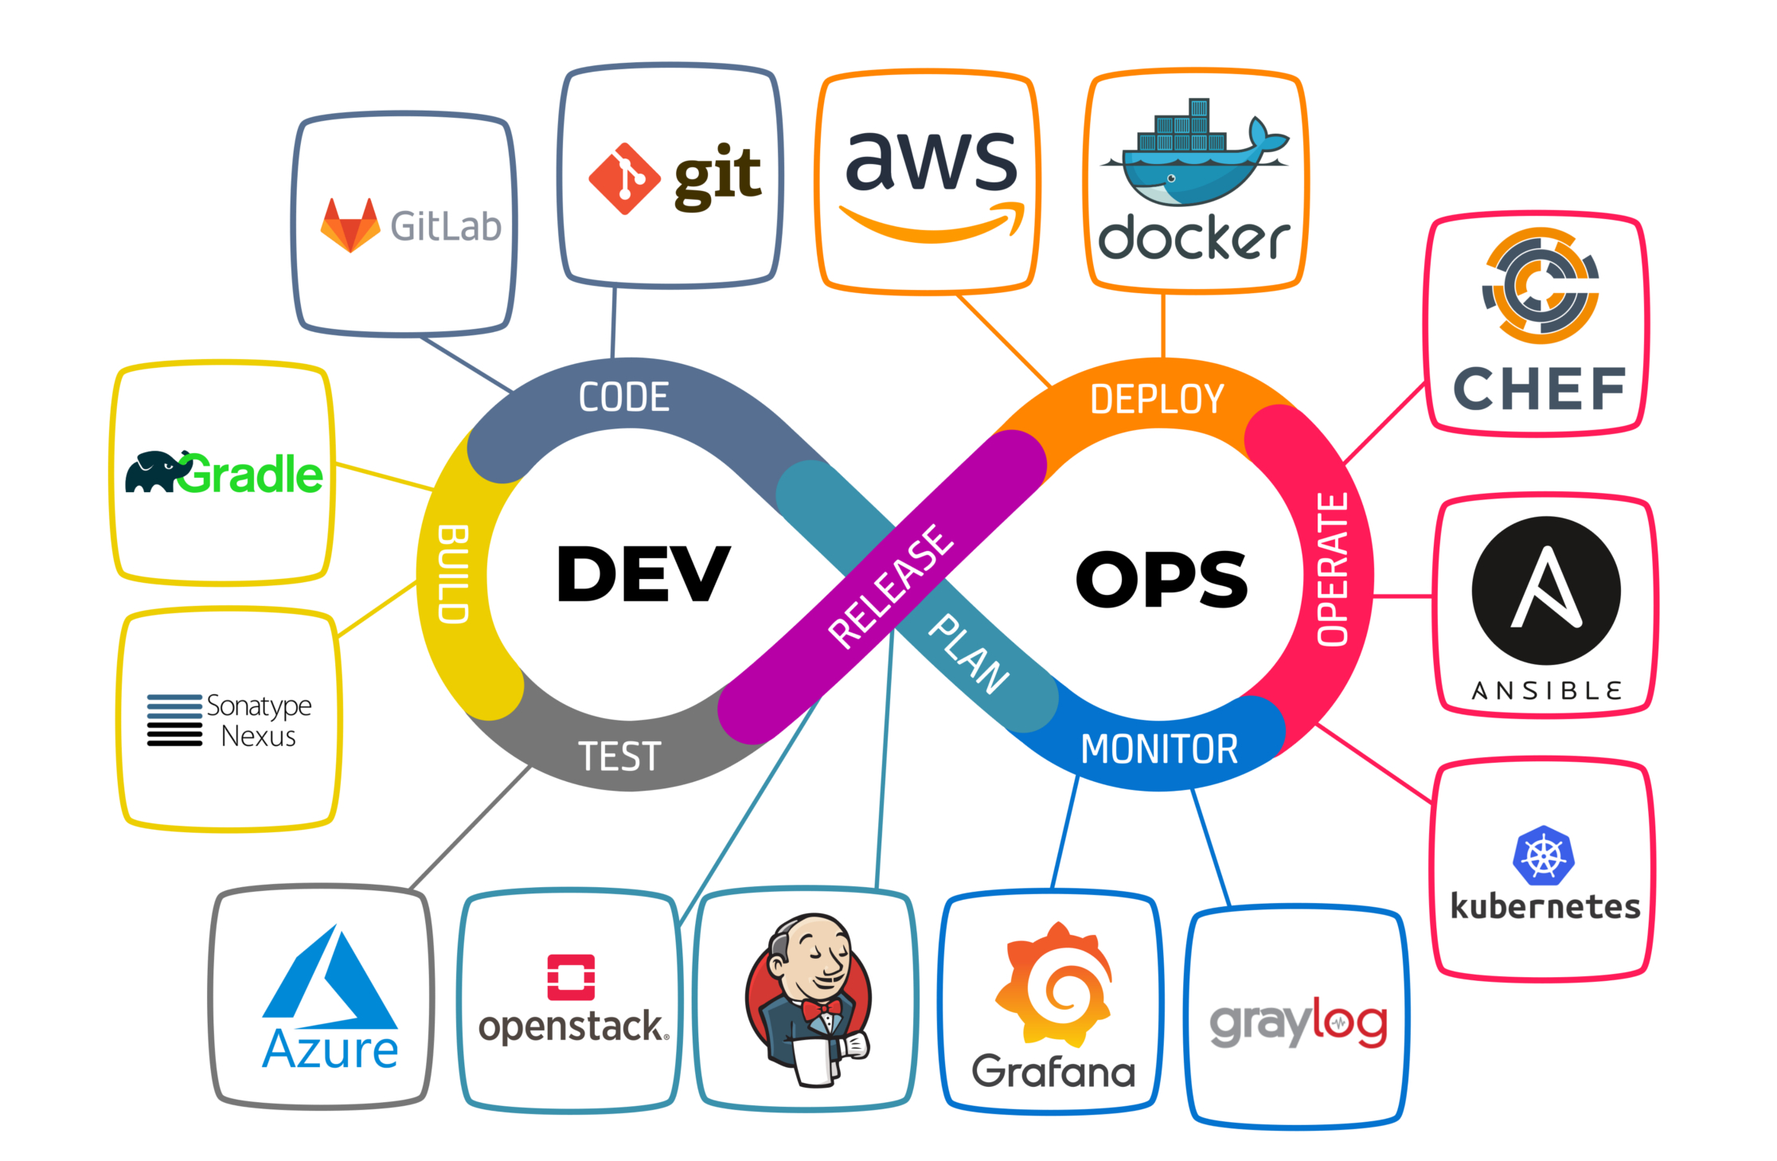

Slide 4

Requirements

Slide 5

Requirements
HT
Functional :
Authentication
Recent conversation with pictures of users or groups.
Activity status (online - Last seen).
Search for Users.
Initiate conversation with user or group.
Real time sending & receiving text messages.
Ability to create new user with name, Profile picture, Email and password.

Slide 6


Requirements
HT
Non-Functional :
1- Security:
The login System using Email & Password
Each User has UID ( User ID ) which is the Password Hashed
2- Usability:
the application should be
easy to use we will also try to provide
Cachat in Arabic & English.

Slide 7
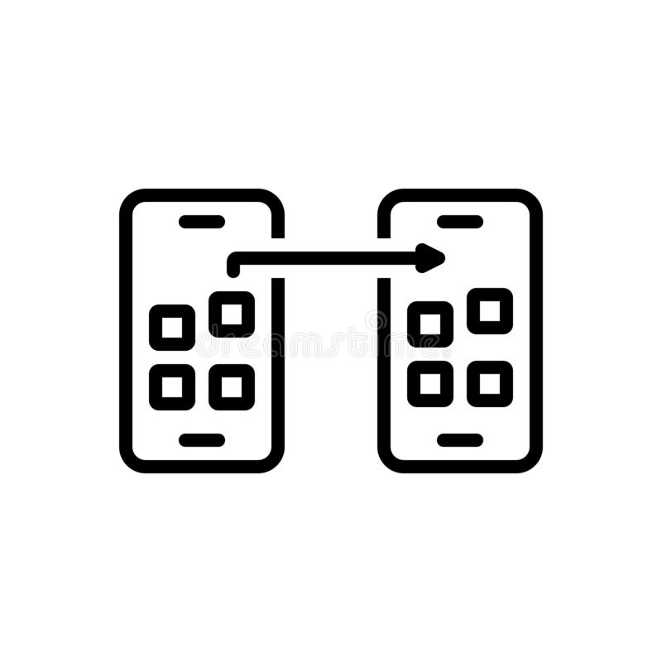

Requirements
HT
Non-Functional :
3- Portability:
User can Login at anytime from
Any device using any version of Cachat
4- Compatibility:
the application should be fully
compatible on both iOS devices
and android devices.

Slide 8


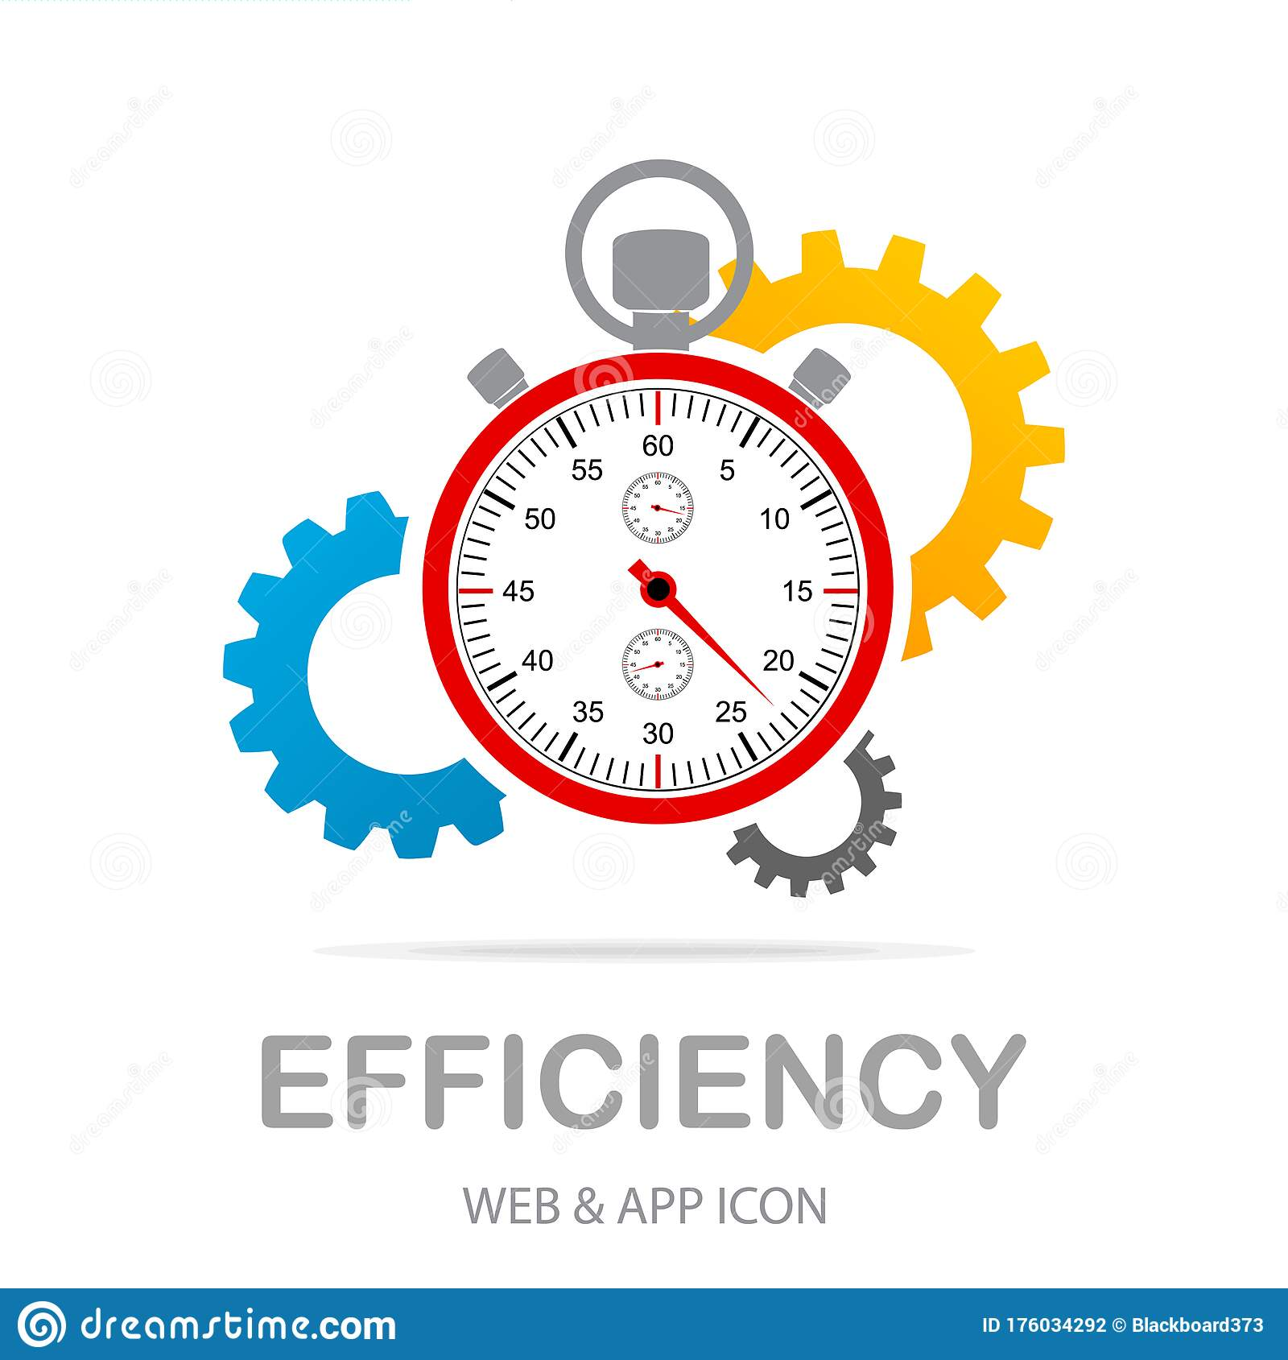
Requirements
HT
Non-Functional :
5- Reliability:
application should be reliable
and performing consistently well.
6- Performance:
application should be lightweight
Which will be ensured while publishing
and send messages instantly.
7- Efficiency:
Gradle and Cocoapods microservices
Is responsible for providing the best library
For the OS version

Slide 9
Diagrams

Slide 10
Data Flow Diagram Explanation:
HT
The user can register, log in and log out from the system then this methods will pass through
Authentication that will be Stord in database as
The data and time which will be used to track
Service as last seen service.
User can: block, find, add, remove another user
And also can send a message and this methods
Will store it in the database.

Slide 11
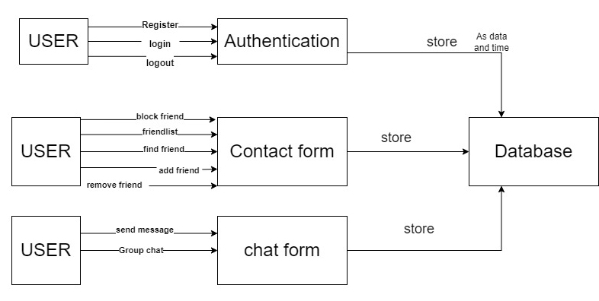
Data Flow Diagram
HT

Slide 12
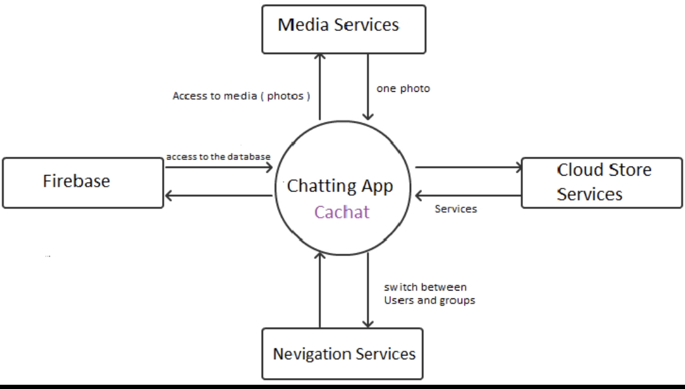

r

Slide 13
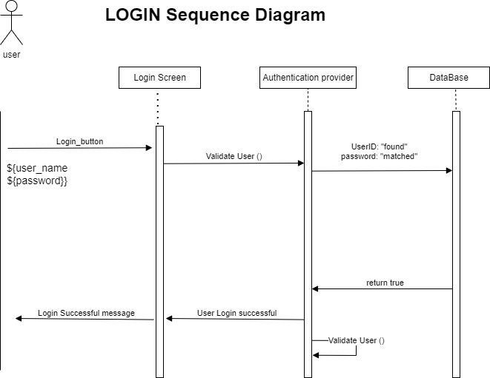

Slide 14
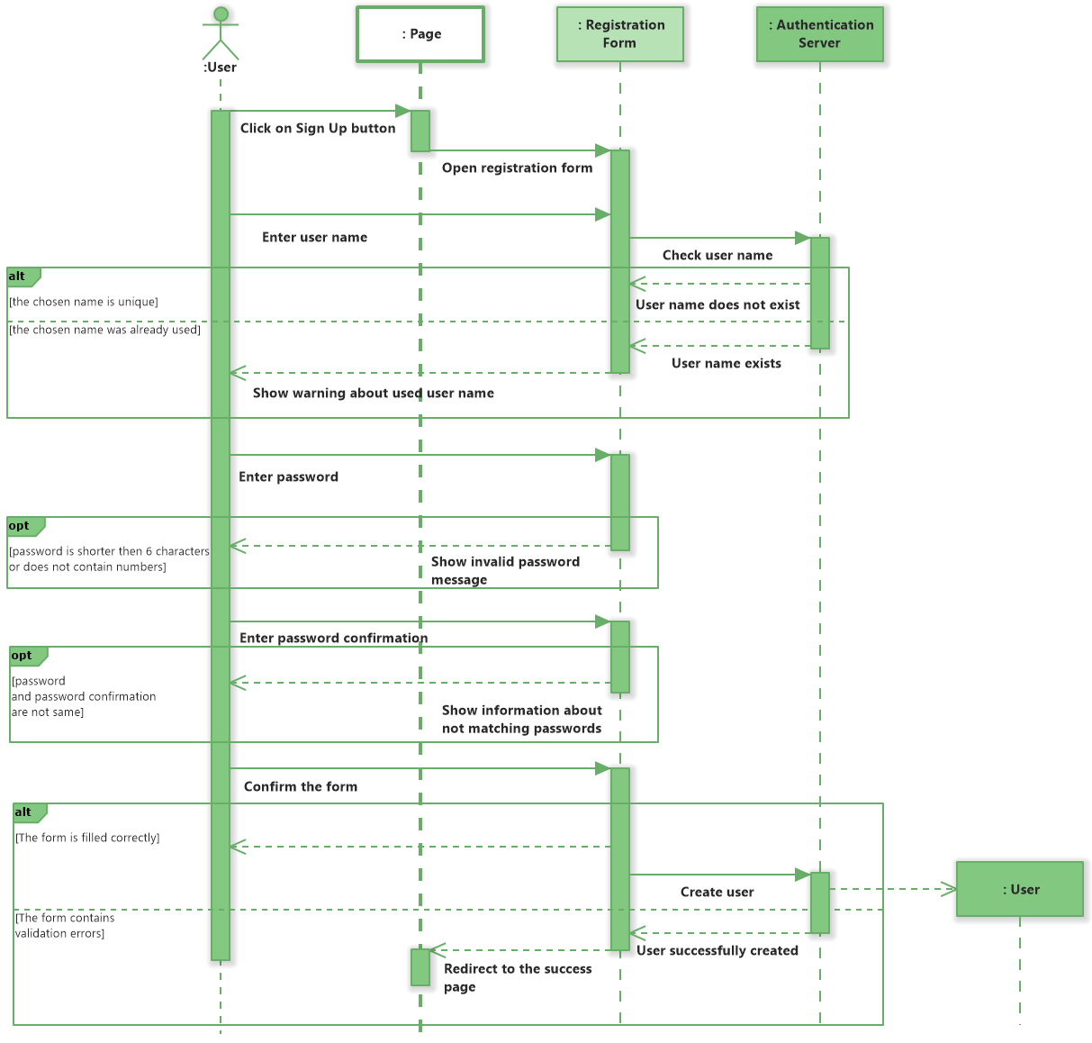

Slide 15
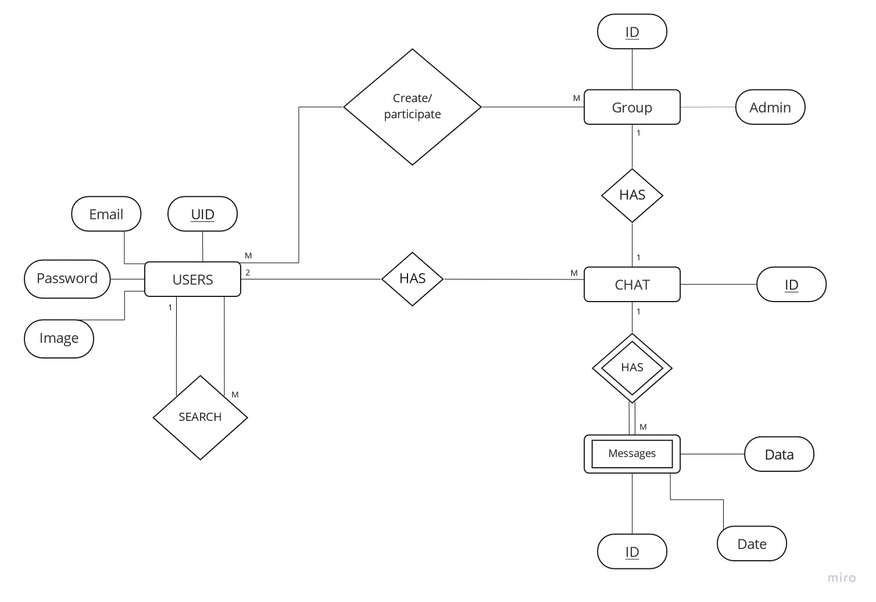

Slide 16
Mircoservices

Slide 17

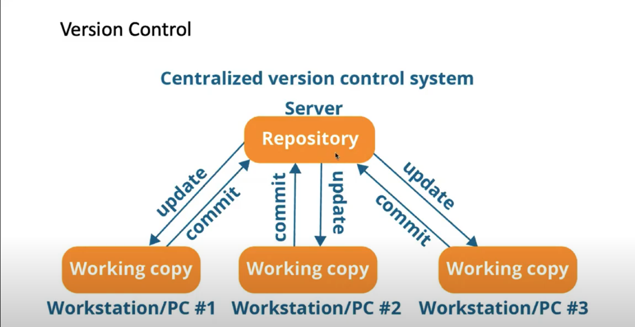

Slide 18
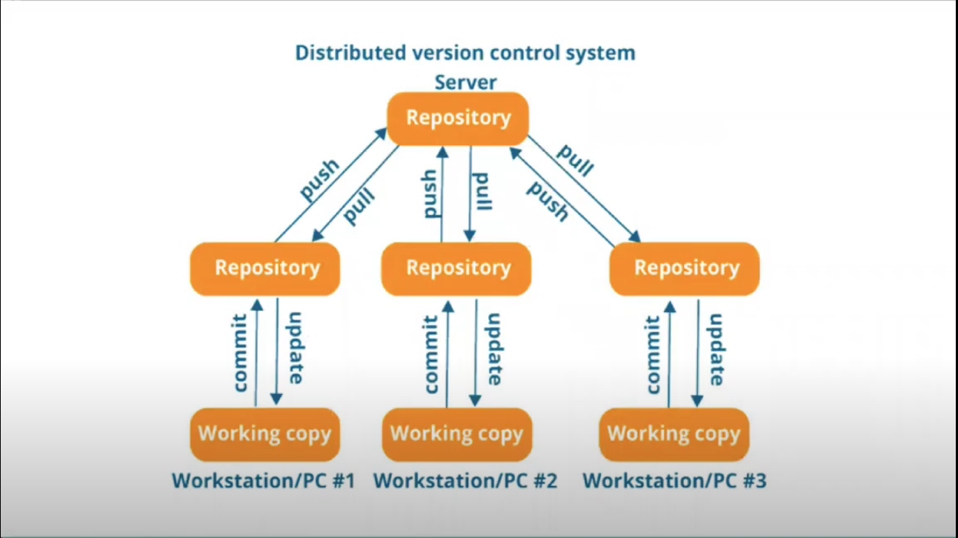

Slide 19

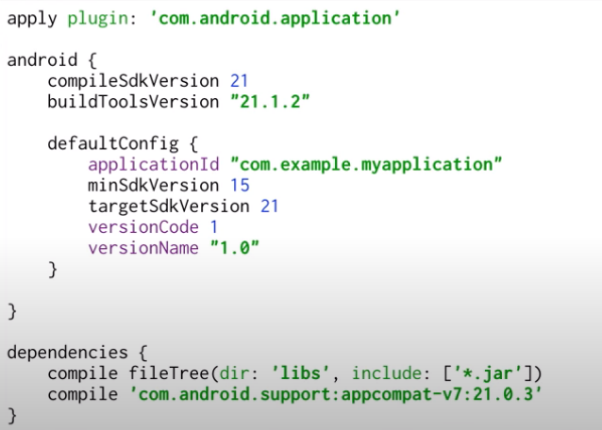
HT

Slide 20
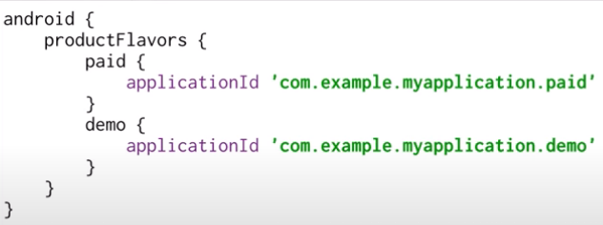
Gradle is a build system, which is responsible for code compilation, testing, deployment and conversion of the code into . dex files and hence running the app on the device

Slide 21
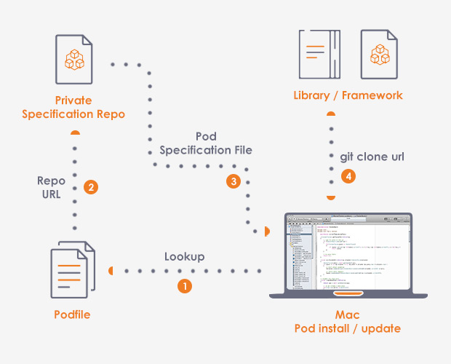

Slide 22

Credits:
Yasmin Khaled
Mostafa Essam
Khaled Hosny
Remas Zakaria
Salma Mahmoud
Omar Sheriff
HexTech

